Slide 1
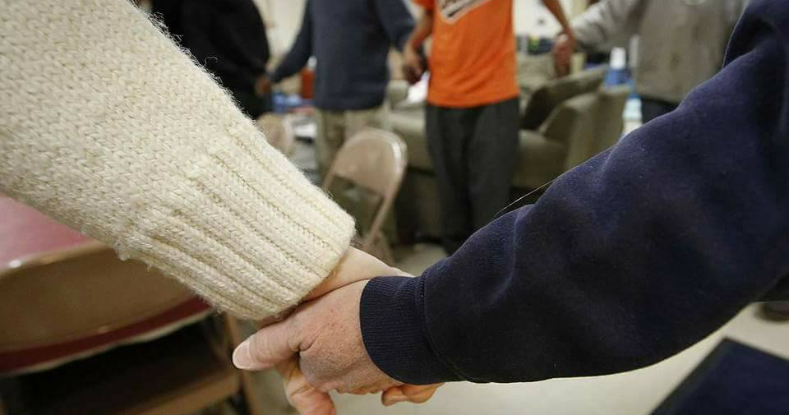
Divine Intervention Ministry
Tippecanoe Presbyterian Church

Slide 2
Ministry to those experiencing Homelessness
Safe warming room open every evening from December 1 — March 31
Guests stay 6pm until 8 am following day
Maximum 25 adult guests per night

Slide 3
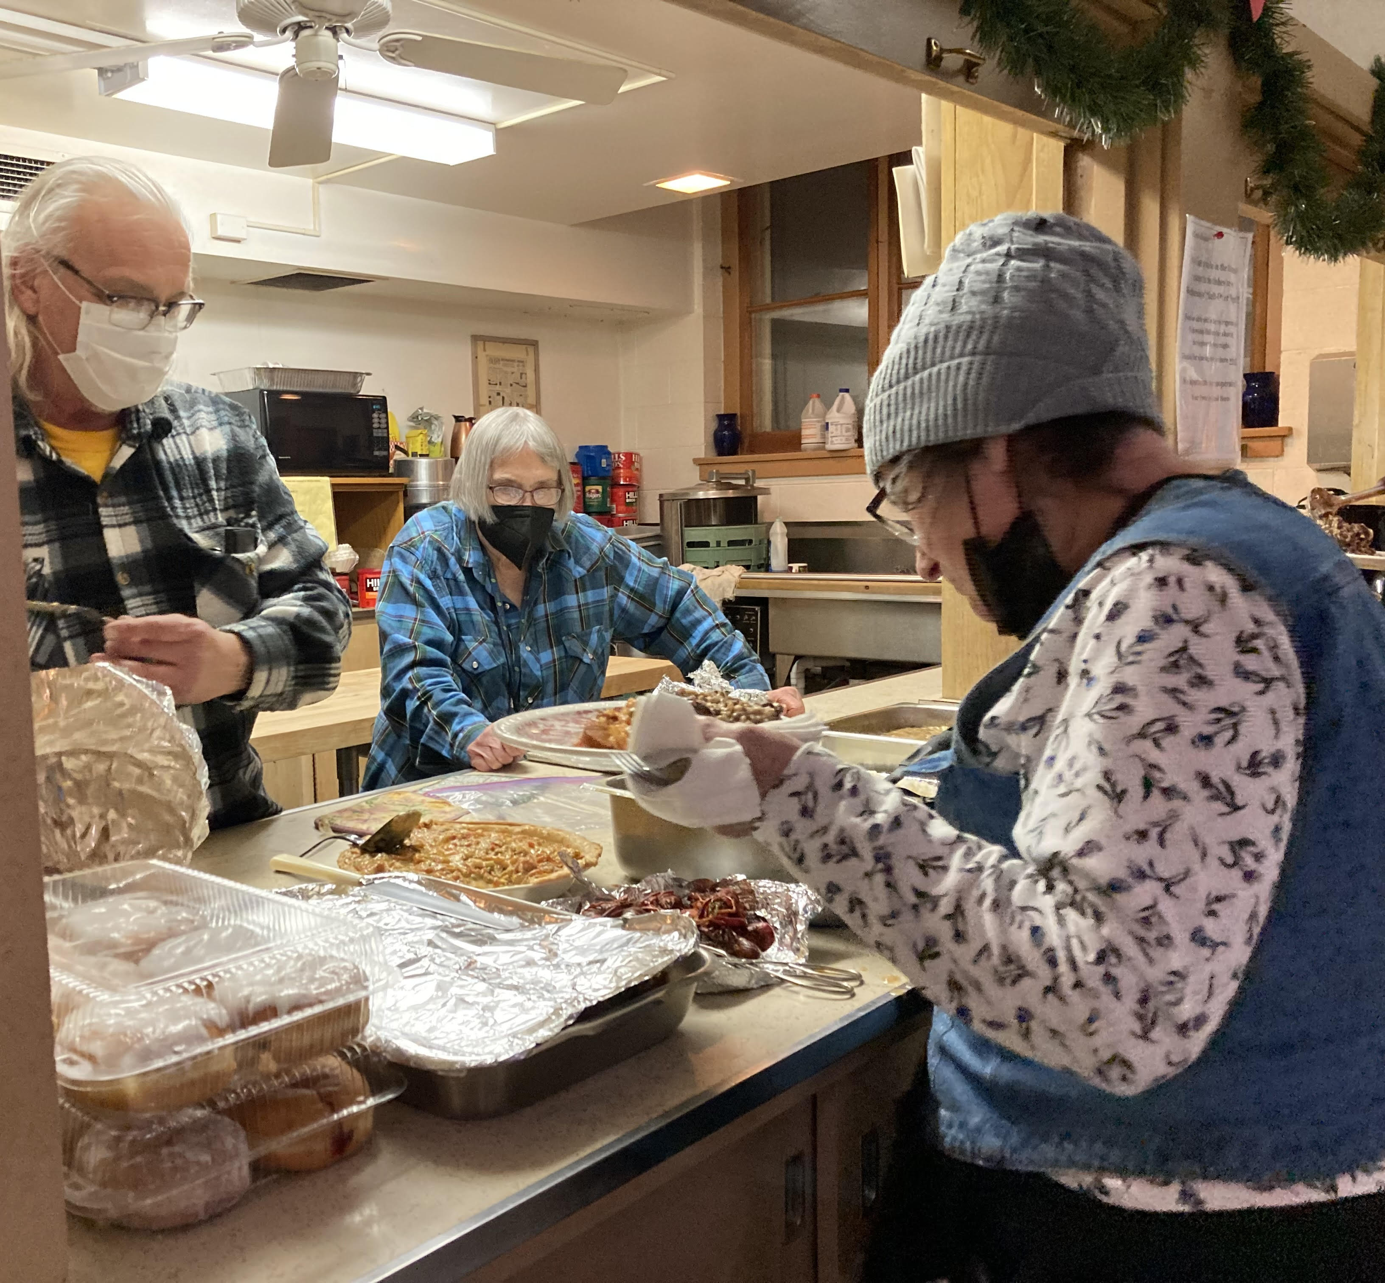
About Our Ministry
Guests and volunteers gather nightly for a family style meal
Warm, safe and supportive space
Create community
Work toward finding home

Slide 4
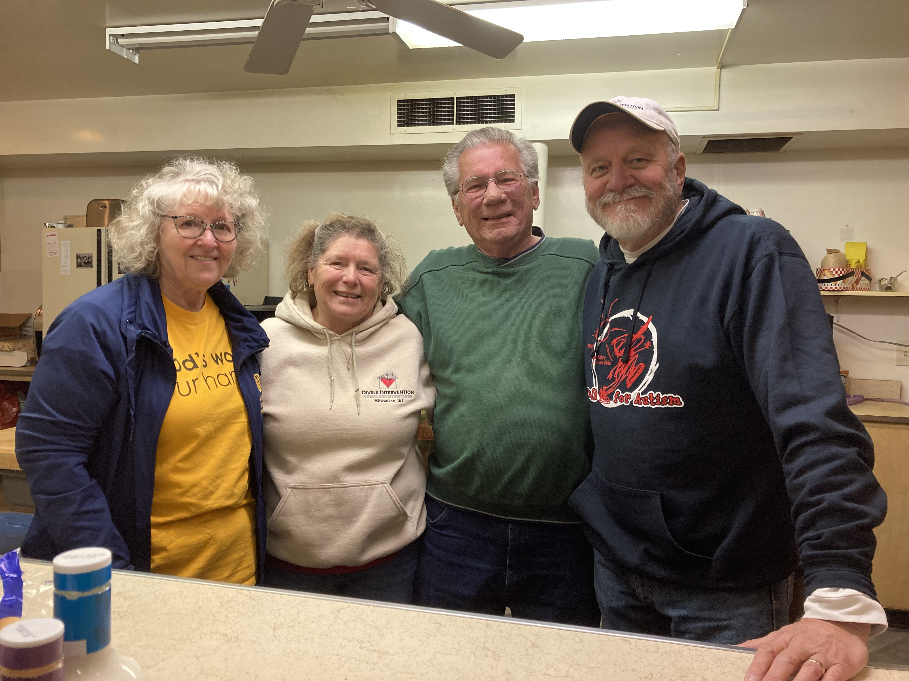
Sustaining Our Ministry
Divine Intervention is fully supported by volunteers to serve as staff, hosts, laundry hosts, and meal providers. We need you!

Slide 5
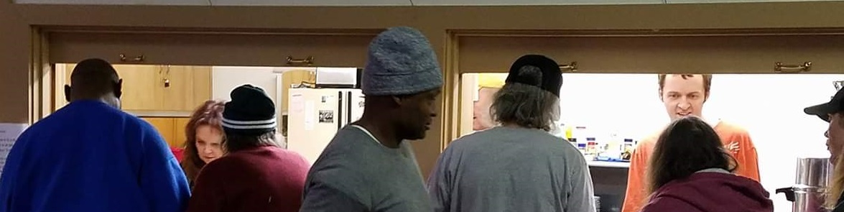
Sustaining Our Ministry
Divine Intervention is 100% funded with private donations from churches, organizations, and individuals. This includes both financial and in-kind donations (e.g., paper towels, toilet paper, breakfast food, condiments, and bus passes).
Seriously, we need you!

Slide 6
The life you change may be your own
Spiritual Growth
Thankfulness for God’s gifts
Live your beliefs and values
Deepen your faith
Increased humility and empathy
Improved listening skills
Appreciation of your gifts
Spend time with people you wouldn’t otherwise meet
Opportunity to serve alongside other compassionate, giving, and caring individuals
Personal Growth

Slide 7
Your Assistance is needed this winter
Overnight Hosts
Overnight Staff
Two Hosts serve from 5:30pm-8:00am and split sleeping shifts for a constant presence in warming room
One Staff person provides onsite leadership from 5:30pm to 8:00am
Training is provided in November and via shadowing throughout the warming season. Staff roles require additional training.

Slide 8
Your Assistance is needed this winter
Meal
Ministry
Laundry ministry
Individuals or groups bring a prepared meal to enjoy with our guests
Provide transportation to and from Tippe and be present at neighborhood laundromat on Sunday afternoons

Slide 9
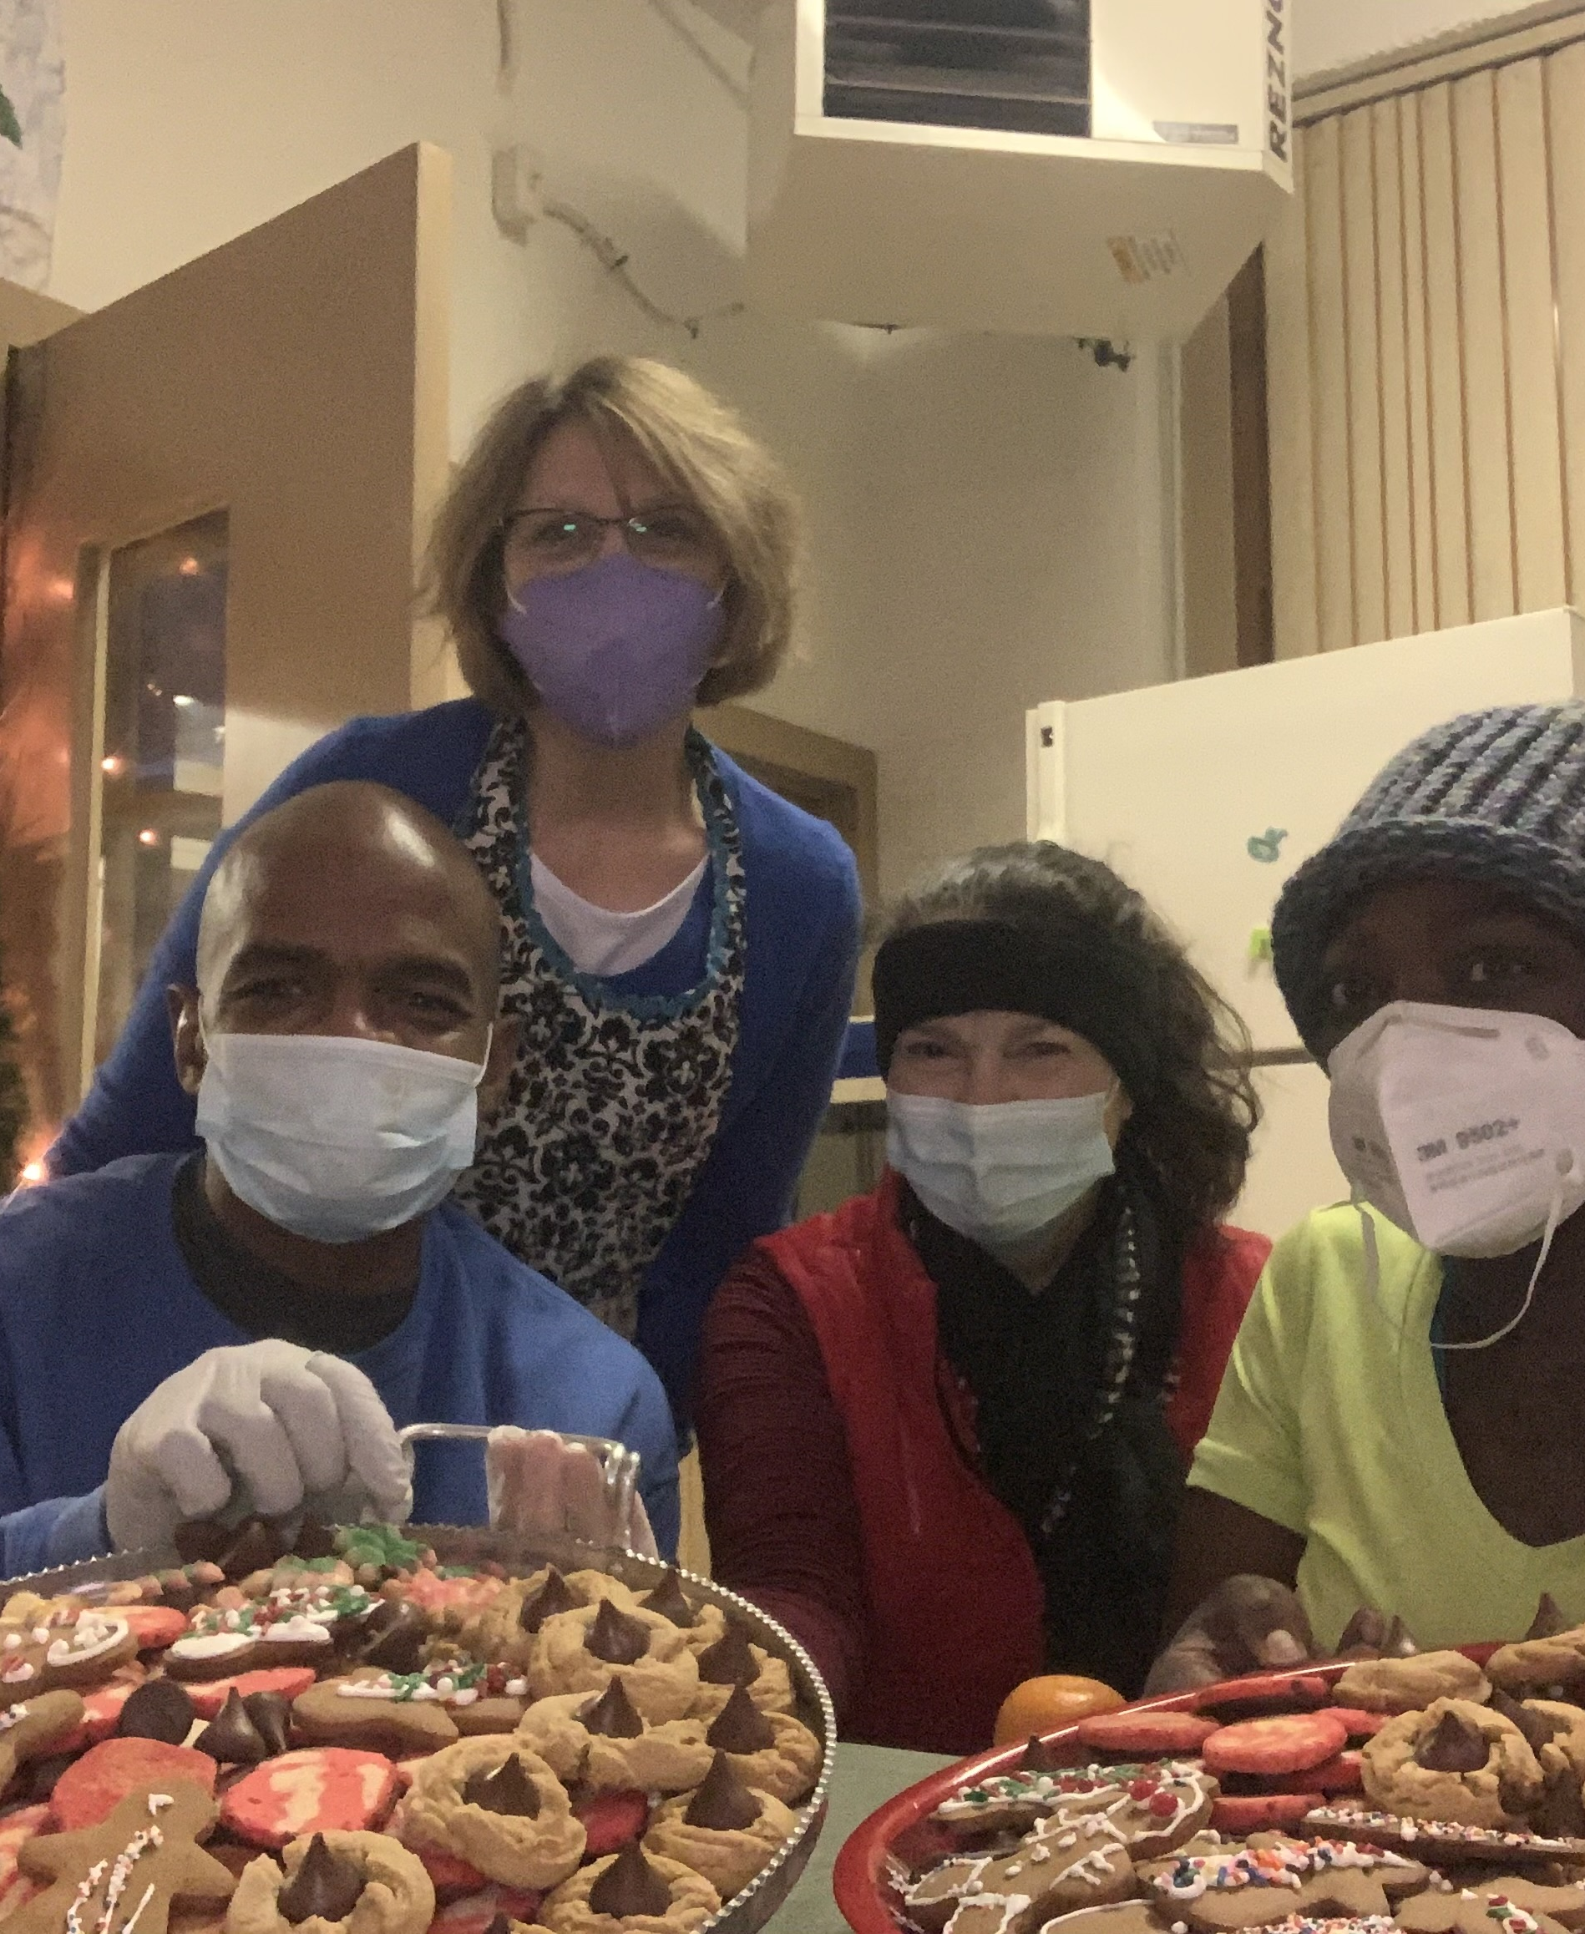
How to Help
Contact us at:
divineinterventiontohomeless@gmail.com
Please follow us on Facebook and Instagram and share our posts with your network.

Slide 10
Your generosity allows 25 people without shelter a warm, safe night of rest.

Slide 11
Thank you! We look forward to serving with you as we make a positive difference in people’s lives this year.
Tippecanoe Presbyterian Church

